Slide 1
Astronomical Ada
Industrial Presentation
Ada-Europe 2017
White Elephant GmbH

Slide 2
Experience report on the problems we encountered getting a program written entirely in Ada to work on three popular PC operating systems:
Windows (WinXp and later)
Linux (Ubuntu Tahr)
OSX (Sierra)

Slide 3
Why Astronomical Ada?
Because the program in question controls astronomical telescopes

Slide 4
Background:
No Motor
Whatever you are watching will gradually drift out of view due to the rotation of the Earth
When aligned with the Earth’s axis cancels out the drift due to the Earth’s rotation.
One Motor
But some objects move relative to the Earth : Eg. Planets, Comets & Satellites
Two Motors
Needs a control system
To know what to follow and how to follow it

Slide 5
Star Database
What is in the night sky and where
SkyTrack
Motor Controller
Stellarium
Control program written in Ada
Open source PC
Planetarium
A method to control telescope motors
GUI
So it can be told where to go and what to follow

Slide 6
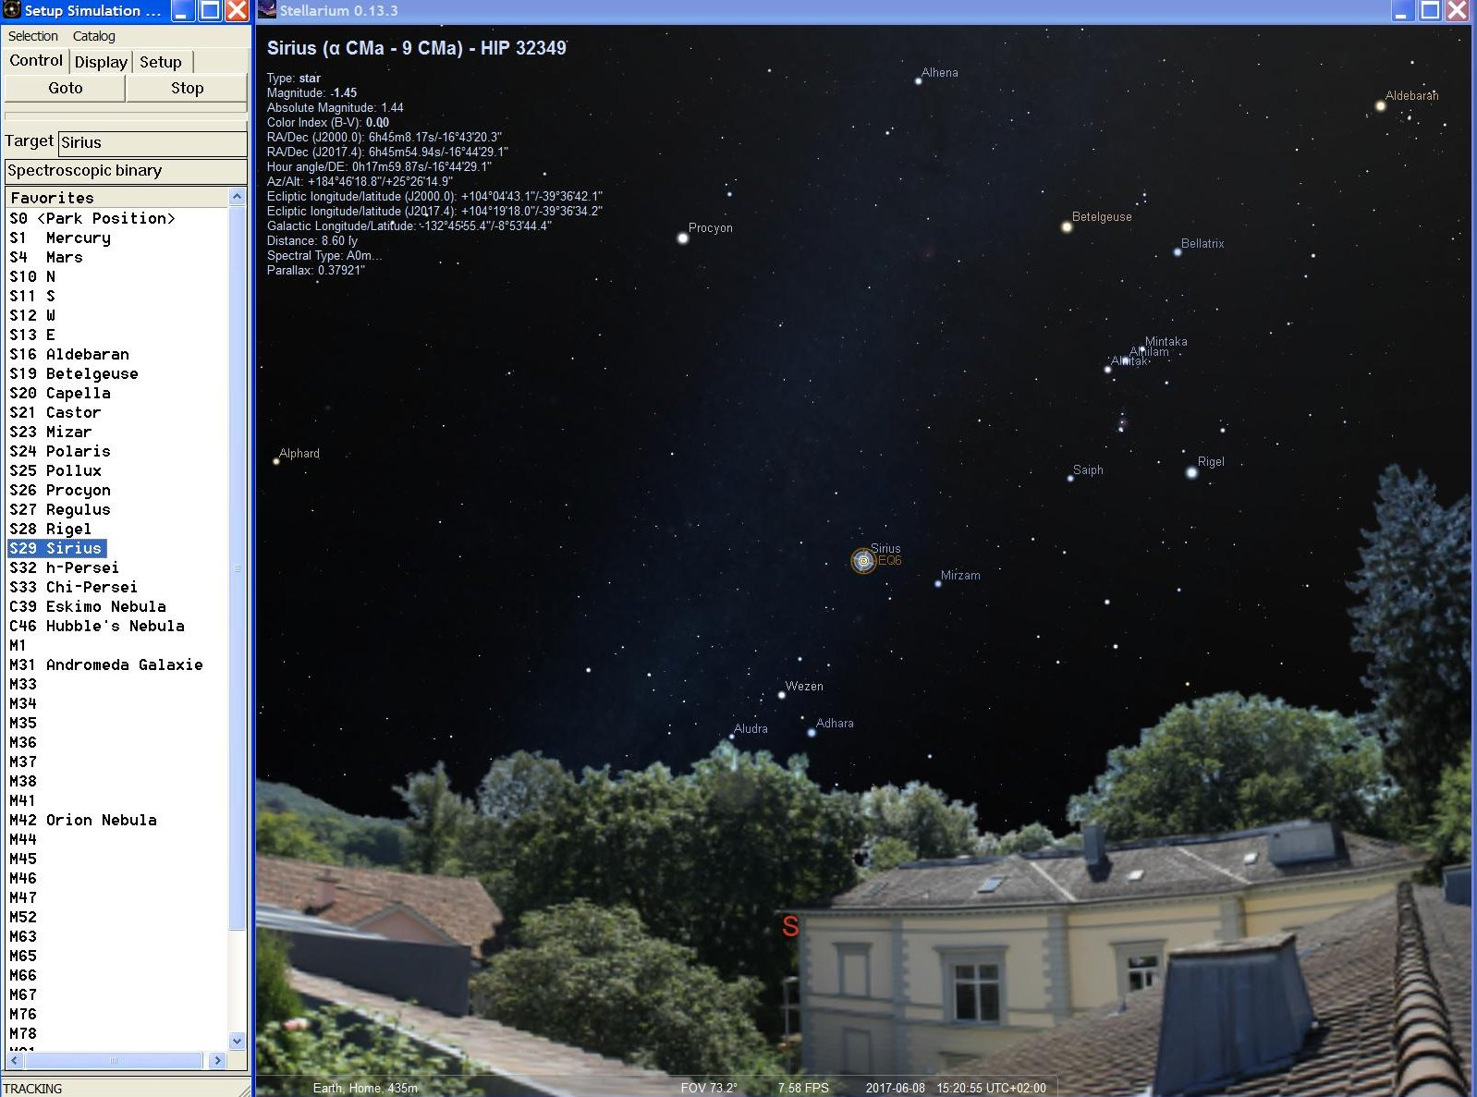

Slide 7
Originally written for MS-Windows
Could it be ported to other operating systems?
Majority of code and know-how is not operating system specific so why limit ourselves to Windows?

Slide 8
Should be easy
Tasks are part of the Ada language
(doesn’t use OS specific libraries to create threads and protected objects)
Compilers for Windows, Linux and OSX
What the language doesn’t supply is mostly provided by packages that have been implemented on various platforms.

Slide 9
However it wasn’t as easy as we thought it was going to be.
In this presentation I want to describe some of the difficulties and our solutions

Slide 10
Five areas of concern:
Accessing the star database
GUI
UDP/IP communication with motor controller
TCP/IP communication with Stellarium
Other OS specific difficulties

Slide 11
1. Accessing the star database
SIMBAD is vast (>9’000’000 entries)
However most objects cannot be seen by amateurs or are of little interest.
This reduces the amount of data entries down to around 20’000 entries

Slide 12
Stars do come and go but…
Compared with the human lifespan, the night sky is relatively static
So we solved the database portability problem by not having a database!

Slide 13
Instead we wrote a program
(of course in Ada)
to convert the SIMBAD data into a very large structured constant
This constant is then compiled and linked into the StarTrack program

Slide 14
Advantages:
Faster
No external file (that can be lost or corrupted)
OS Independent

Slide 15
2. GUI
Written using a package that provides a simple interface to create and manipulate common graphical objects.
Originally implemented using direct calls to the Windows API
So all we had to do was re-implement the implementation.

Slide 16
Surprisingly easy to do.
We chose to re-implement our GUI package
based on Gtk
because it was available on all the target platforms
and Ada Bindings were available.

Slide 17
Windows
Windows API not task safe.
So use protected objects to prevent concurrent API calls
and an Ada task to process the Windows message loop.

Slide 18
Gtk
Restriction:
All Gtk calls MUST be executed from the SAME task
Solved using Ada:
Protected types
Task requeuing
Abstract types and procedures
Guarded entries

Slide 19
Gtk – Two types of call
Synchronous:
Calls to Gtk that return a value
For example, get the contents of an edit box
Asynchronous:
Calls to Gtk that do not return a value
For example, write into a list view

Slide 20
Synchronous
Request
Gui
Task
Result

Slide 21
Coding
type Request_Data is abstract tagged null record;
procedure Synchronous_Service (Data : in out Request_Data) is abstract;
Extend the Request_Data type to include the data to be sent to Gtk
and to be received from Gtk.
type Check_Enquiry_Data is new Gui.Router.Request_Data with record
Check_Box : Gtk.Check_Button.Gtk_Check_Button;
Is_Checked : Boolean;
end record;
Define the routine that the Gtk task should call to process the data
overriding
procedure Synchronous_Service (Data : in out Check_Enquiry_Data) is
begin
Data.Is_Checked := Data.Check_Box.Get_Active;
end Synchronous_Service;

Slide 22
Coding
type Request_Data_Ptr is access all Request_Data'class;
protected Gateway is
entry Synchronous_Request (Data : in out Request_Data'class);
private
entry Serviced (Unused_Data : in out Request_Data'class);
State : Gateway_State := Idle;
Data : Request_Data_Ptr;
end Gateway;
To perform a Gtk synchronous operation:
Create a variable of the extended data type and initialise it
Pass the data into the Gtk Gateway (a protected type)
When control is returned, extract the results and pass them back to the caller.
function Is_Checked (The_Check_Box : Check_Box) return Boolean is
Data : Check_Enquiry_Data := (Gui.Router.Request_Data with
Check_Box => The_Check_Box.The_Box,
Is_Checked => False);
begin
Gateway.Synchronous_Request (Data);
return Data.Is_Checked;
end Is_Checked;

Slide 23
Coding
The Synchronous request blocks until the Gtk task is ready to process the request (State=Idle)
Then it makes a private pointer to the request data and changes the change to Busy;
It then blocks until the Gtk task makes a rendezvous with it to signal that the Synchronous procedure has completed.
entry Synchronous_Request (Data : in out Request_Data'class)
when State = Idle is
begin
Gateway.Data := Data'unchecked_access;
State := Busy;
requeue Serviced;
end Synchronous_Request;
entry Serviced (Unused_Data : in out Request_Data'class)
when State = Ready is
begin
State := Idle;
end Serviced;

Slide 24
Coding
protected Gateway is
entry Complete_Synchronous_Service;
entry Check;
end Gateway;
function Synchronous_Data return Request_Data_Ptr;
The Gtk task calls check to wait for something to do
When released it performs the synchronous routine associated with the extended type pointed to by its private pointer
Then it calls Complete_Synchronous_Service to change the state to Ready thereby releasing the caller.
loop
Gateway.Check;
Synchronous_Service (Gateway.Synchronous_Data.all);
Gateway.Complete_Synchronous_Service;
end loop;

Slide 25
Coding
entry Check
when (State = Busy) is
begin
null;
end Check;
function Synchronous_Data return Request_Data_Ptr is
begin
return Gateway.Data;
end Synchronous_Data;
procedure Complete_Synchronous_Service is
begin
State := Ready;
end Complete_Synchronous_Service;
loop
Gateway.Check;
Synchronous_Service (Gateway.Synchronous_Data.all);
Gateway.Complete_Synchronous_Service;
end loop;

Slide 26
Asynchronous
Request
Gui
Task
Queue

Slide 27
Coding
type Message_Data is abstract tagged null record;
procedure Asynchronous_Service (Data : Message_Data) is abstract;
Extend the Message_Data type to include the data to be sent to Gtk.
type Set_Check_Data is new Gui.Router.Message_Data with record
Check_Box : Gtk.Check_Button.Gtk_Check_Button;
Is_Set : Boolean;
end record;
Define the routine that the Gtk task should call to process the data
overriding
procedure Asynchronous_Service (Data : in out Set_Check_Data) is
begin
Data.Check_Box.Set_Active (Data.Is_Set);
end Asynchronous_Service;

Slide 28
Coding
To perform a Gtk Asynchronous operation:
Create a variable of the extended data type and initialise it
Append the data to a queue (accessed via the gateway protected type)
The Asynchronous operation does NOT block.
procedure Set (The_Check_Box : Check_Box) is
Data : Set_Check_Data := (Gui.Router.Message_Data with
Check_Box => The_Check_Box.The_Box,
Is_Set => True);
begin
Gateway.Asynchronous_Request (Data);
end Is_Checked;

Slide 29
Coding
package Message_List is new Ada.Containers.Indefinite_Doubly_Linked_Lists
(Message_Data'class);
protected Gateway is
procedure Asynchronous_Request (Data : in Message_Data'class);
private
The_Messages : Message_List.Item;
end Gateway;
protected body Gateway is
procedure Asynchronous_Request (Data : in Message_Data'class) is
begin
The_Messages.Append (Data);
end Asynchronous_Request;
end Gateway;

Slide 30
Coding
The Gtk task calls check to wait for something to do
Either the state indicates that there is a synchronous operation to perform or if the message queue is not empty then there is an asynchronous operation to perform.
entry Check (The_Data_Type : out Data_Type)
when not (State = Busy) or else (The_Messages.Count > 0) is
begin
if The_Messages.Count > 0 then
The_Data_Type := Asynchronous;
elsif State = Busy then
The_Data_Type := Synchronous;
end if;
end Check;

Slide 31
Coding
If there is something in the message queue then retrieve it and perform the Asynchronous routine associated with it.
loop
Gateway.Check (The_Data_Type);
case The_Data_Type is
when Synchronous =>
Synchronous_Service (Gateway.Synchronous_Data.all);
Gateway.Complete_Synchronous_Service;
when Asynchronous =>
Asynchronous_Service (Gateway.Next_Message);
Gateway.Delete_First_Message;
end case;
end loop;

Slide 32
Coding
The Gtk processing loop:
loop
while Gtk.Main.Events_Pending loop
Unused_Boolean := Gtk.Main.Main_Iteration;
end loop;
select
Gateway.Check (The_Data_Type);
case The_Data_Type is
when Synchronous =>
Synchronous_Service (Gateway.Synchronous_Data.all);
Gateway.Complete_Synchronous_Service;
when Asynchronous =>
Asynchronous_Service (The_Messages.First_Elelemt);
The_Messages.Delete_First;
end case;
or
delay The_Period;
end select;
end loop;

Slide 33
But…
Whilst this worked for both Linux and Windows it didn’t work for OSX
For some reason, under OSX, the Gtk task MUST be the main task rather than a task (thread) created by Ada.
This restriction meant we had to modify not only our GUI interface but also how the program setup the Gui Objects.

Slide 34
Before:
Create Gtk task
Create GUI objects using interface to Gtk task
GUI Close terminates Gtk loop and exits Gtk task
After:
Execute Gtk procedure from main task
Gtk procedure calls start-up procedure that creates all the GUI objects
GUI Close terminates the Gtk loop and exits the Gtk procedure.

Slide 35
Because the main task can now request Gtk operations, this has to be detected and the routines executed directly rather than by rendez-vous or queue.
procedure Request (Data : in out Request_Data'class) is
use type Ada.Task_Identification.Task_Id;
begin
if The_Gtk_Task = Ada.Task_Identification.Current_Task then
Synchronous_Service (Data);
else
Gateway.Synchronous_Request (Data);
end if;
end Request;
procedure Send (Message : Message_Data'class) is
use type Ada.Task_Identification.Task_Id;
begin
if The_Gtk_Task = Ada.Task_Identification.Current_Task then
Asynchronous_Service (Message);
else
Gateway.Asynchronous_Request (Message);
end if;
end Send;

Slide 36
3. UDP/IP
SkyTrack uses UDP/IP Ethernet datagrams to communicate with the motor control
UDP is used because it is more suitable for real-time.
SkyTrack sends a steady stream of datagrams to the motor controller instructing it what it should do in the near future. It doesn’t matter if some of these get lost. More important is that they are sent immediately and not buffered and sent at some arbitrary time in the future.

Slide 37
Gnat Sockets
Gnat sockets is implemented on all of our target platforms
The Gnat sockets API very similar to the native Windows API we had been using.
So converting to Gnat Sockets was trivial.
But unfortunately it only worked under Windows!
To get SkyTrack working under Linux and OSX required a bit more effort.
The problem was due to the concept of UDP connections.

Slide 38
UDP connections
UDP is inherently connectionless
UDP datagrams are sent to a destination IP address and port.
There is no guarantee that it will get to the recipient, nor is there any guaranteed way of knowing whether the recipient received the datagram or even if the recipient exists.
TCP has connections but UDP doesn’t
However Windows likes to pretend that it does.

Slide 39
UDP connections
The villain in all this is the Gnat Socket routine Connect_Socket
procedure Connect_Socket (Socket : Socket_Type;
Server : Sock_Addr_Type);
-- Make a connection to another socket which has the address of Server.
-- Raises Socket_Error on error.
Which allows the destination IP address to be associated with a socket.
Once this socket has been connected you can send datagrams to the Server without having always to specify the Server’s address
procedure Send_Socket (Socket : Socket_Type;
Item : Ada.Streams.Stream_Element_Array;
Last : out Ada.Streams.Stream_Element_Offset;
Flags : Request_Flag_Type := No_Request_Flag);

Slide 40
UDP connections
We used this because it seemed convenient for the socket to hold the server’s IP address so that it didn’t need to be specified every time a UDP datagram was sent.
And it worked under windows!
We naively thought that all Connect_Socket did was store the server’s IP address in the socket structure.
After all – UDP is connectionless, what more could it do?
Well a lot more –
and this extra only works under Windows!

Slide 41
UDP connections
Connect_Socket uses NetBios to attempt to determine whether or not the Server specified by its IP address exists.
Unfortunately NetBios is a Windows protocol that Linux only supports if an add-on has been installed and OSX doesn’t support it at all.
The solution is easy.
Don’t use Connect_Socket.
Remember the Server’s IP address in your own structure and use the send variant that requires the destination IP address
procedure Send_Socket(Socket : Socket_Type;
Item : Ada.Streams.Stream_Element_Array;
Last : out Ada.Streams.Stream_Element_Offset;
To : Sock_Addr_Type;
Flags : Request_Flag_Type := No_Request_Flag);

Slide 42
UDP connections
If you need to know if the destination exists then use a protocol.
Send the destination a datagram and check the response.
Don’t rely on the system to do this for you.
Lesson learnt:
Just because a package offers a capability doesn’t mean that it works on all platforms.

Slide 43
4. TCP/IP
SkyTrack acts as a TCP/IP server for Stellarium to connect to.
A task opens a port using a TCP/IP socket and waits indefinitely for connections.
procedure Accept_Socket (Server : Socket_Type;
Socket : out Socket_Type;
Address : out Sock_Addr_Type);
When Skytrack was shutdown it closed the socket.
Under Windows this released the task waiting on the Accept with an exception.
But not under Linux.
Under Linux the task waiting on the Accept was NOT released.

Slide 44
TCP/IP
The Solution is to use Socket Selectors.
Net.Set (R_Socket_Set, The_Listener.The_Socket);
Net.Check_Selector (Selector => The_Listener.The_Selector,
R_Socket_Set => R_Socket_Set,
W_Socket_Set => W_Socket_Set,
Status => The_Status,
Timeout => The_Select_Timeout);
Wait until something becomes available on the socket and then accept it
When SkyTrack is shutdown it aborts the selector which releases the task waiting on Check_Selector
returning Status = Aborted
procedure Abort_Selector (Selector : Selector_Type);

Slide 45
TCP/IP
Lesson learnt:
Packages can behave differently on different target platforms.

Slide 46
5. Other difficulties
Who am I?
Am I the only one?
Where shall I write?

Slide 47
Who am I?
How should we remember settings and configurations?
Under Windows we used the registry.
To be platform neutral we should write these either as an .ini or XML file.
But:
Where should configuration files be placed?
What should the file be called?
Who am I – What am I called?
Could be hardcoded.
After all we know the name of the program.
However this is a poor solution for code that may be shared between many programs.

Slide 48
Unfortunately there doesn’t seem to a Platform neutral method of finding out what the currently executing program is called.
Some have suggested that
Ada.Command_Line.Command_Name
returns the name of the program.
However it is relatively easy to demonstrate that this is not the case.
It returns the command used to start the program.
Which is not the same thing at all.
Because there is no Ada way of finding out the name of the program we had to make our own package to provide this function and then make three implementations.
One for each platform.

Slide 49
Likewise we had to implement a target specific function to return whether or not the current program was already executing.
We also had to write OS specific code to decide where to place application data.
This also required the program to know what operating system it was running on.

Slide 50
Conclusion
We were successful – StarTrack is available on all three of our chosen platforms with over 99% of the code platform independent.
But...
Unfortunately NOT 100%
We think that routines are missing from the Ada library.
And...
Gnat.Sockets was far from ideal.
Poor design (based on Berkeley sockets?)
No support for IP6
We think that networking should be part of the Ada language.

Slide 51
END
Questions?

